Slide 1

The toxic remnants by TEAM SUN TSU (Teodor, Sofija, Uroš)

Slide 2
Team project
The toxic remnants, bullethell with skeletons
Dynamic shooter with a lot of movement (inspired by games like Enter the gungeon and Binding of Isac)
Can be found here: team/sun_tsu/main
Notes:
You should have a working knowledge
of basic object-oriented programming concepts and at least some experience
programming in C++.

Slide 3
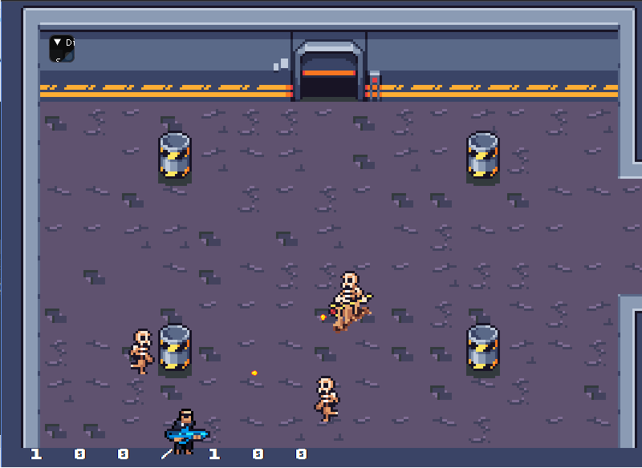
Entry level, to get you started
Notes:
You should have a working knowledge
of basic object-oriented programming concepts and at least some experience
programming in C++.

Slide 4
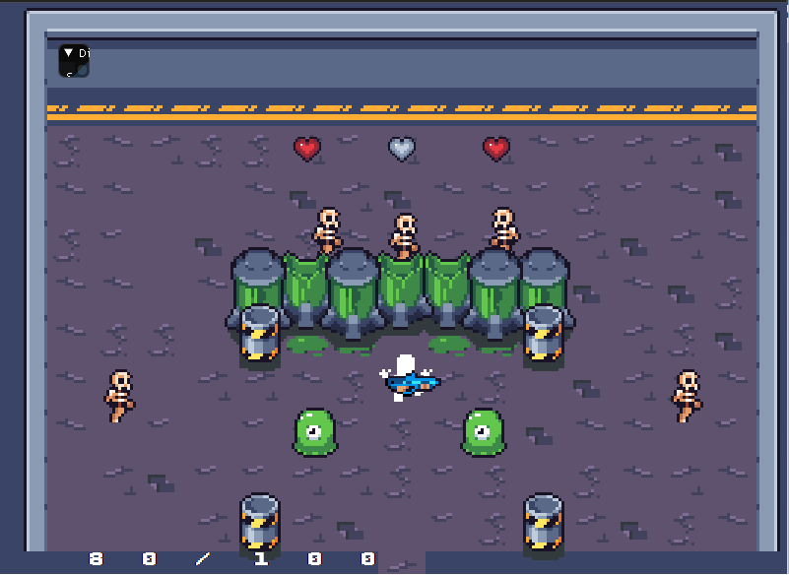
Our favorite room, by far

Slide 5
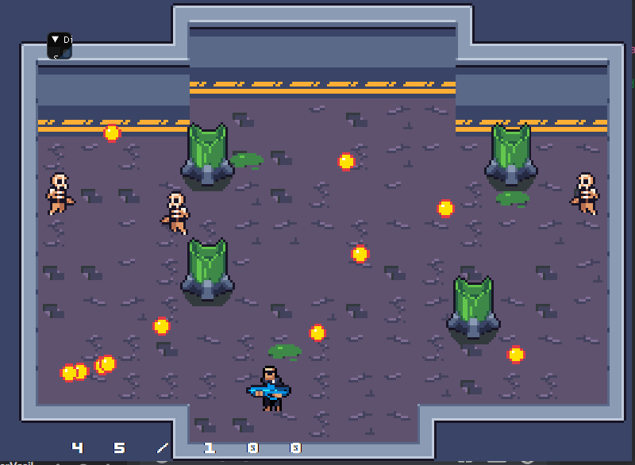
The boss room – there's no escape

Slide 6
Team members
Sofija Bošković, bug catcher
Teodor Vasiljević, enemy leader
Notes:
You should have a working knowledge
of basic object-oriented programming concepts and at least some experience
programming in C++.

Slide 7
Game description
The main mechanics of the game are running, shooting and dodging enemy projectiles
Player is in an abandoned lab, and his goal is to clear the lab from remnants of a failed experiment that resulted in a lab full of mutated skeletons and slimes, and then beat the final bosses
Along the way are many dangerous enemies
Notes:
You should have a working knowledge
of basic object-oriented programming concepts and at least some experience
programming in C++.

Slide 8
Game features-Controls
Anyone who played a few shooter games should feel at home when it comes to the commands. ASDW keys are used for movement(that you can speed up holding left shift), and the mouse is used for shooting. Since we are in a 2D space, bullets follow the mouse cursor location. You can restart the game at any time using the space key.
Movement was implemented by Sofija
Shooting was implemented by Teodor
Notes:
You should have a working knowledge
of basic object-oriented programming concepts and at least some experience
programming in C++.

Slide 9
Game features-gameplay mechanics
Our focus was on designing a fun and well decorated map (the lab) that would be challenging, but interesting to play on (Sofija was the main contributor)
We've also added some interesting enemies, that have different attacks and movement patterns, as well as come collectables, to make the players lives a bit easier (that was Teodor's main focus)
Notes:
You should have a working knowledge
of basic object-oriented programming concepts and at least some experience
programming in C++.

Slide 10
Game features-demo level
The first, and the only (for now) level in the game is taking place in the lab. Using the tilemap system and some interesting assets, we were able to create the map
Implemented by Sofija
Notes:
You should have a working knowledge
of basic object-oriented programming concepts and at least some experience
programming in C++.

Slide 11
Game features-ending
The game can end in one of two ways:
Player gets overpowered by the enemies and dies
Player clears all the rooms and defeats the final bosses
Implemented by Sofija and Teodor (respectively)
Notes:
You should have a working knowledge
of basic object-oriented programming concepts and at least some experience
programming in C++.

Slide 12
Game features-other features
Level editor: using the tilemap system we were able to easily switch between rooms on the map
Health monitor-monitors the players health and shows it on screen
We've implemented the aiming system that that compares the players current location and the location of the mouse, adjusting the velocity vector of the bullet
We've аlso added the health pickups, because with adding more enemies, the game was getting more and more difficult. We also have a collectable that increases players maximum health
Implemented by Sofija and Teodor
Notes:
You should have a working knowledge
of basic object-oriented programming concepts and at least some experience
programming in C++.

Slide 13
Sofija
Setting up dagger for Linux
Existing code analysis, getting familiar with systems
Three strikes-racing player game feature
Player character and his movement, platformer player controller(drink potion, attack,…)
Tilemap loading system and spritesheets
Collisions
Room transition,
player health and death
Animations, restart feature and level design
Bug fixes and style changes
Teodor
Converting from Linux to Windows, setting up
Getting to know the engine, trying to make slight changes
Added vertical movement to racing game
Jump for the platformer game
Shooting for the team game, tweeking the movement
Added basic enemies
Different enemy movement and shooting
Added new enemies, solving some collision problems
Bosses, positive ending, some style changes, collectables
Notes:
You should have a working knowledge
of basic object-oriented programming concepts and at least some experience
programming in C++.

Slide 14
Postmortem
This was a great educational and fun experience. We learned a lot about game design, as well as programming along the way
We also had an opportunity to work with wonderful people at Ubisoft who were very patient and ready to help 24/7
Notes:
You should have a working knowledge
of basic object-oriented programming concepts and at least some experience
programming in C++.

Slide 15
Postmortem-planned but not implemented
We had an idea of adding a key that would be required to enter the boss room, which would incentivize the player to explore the entire map
We wanted to implement a timer that would be also used as ending points-the more time you have left the more points you have
Exp for killing enemies
Exploding potion attack from collectable potions that you get from chests (but with a risk factor you can get poisoned)
Poison that slowly kills the player(and makes them look for the health potion FAST) that you can get from staying to long in high toxic level rooms and enemy poison attacks
Notes:
You should have a working knowledge
of basic object-oriented programming concepts and at least some experience
programming in C++.

Slide 16
Postmortem-what went wrong?
A couple of time-consuming bugs at the end, but they are all fixed!
Notes:
You should have a working knowledge
of basic object-oriented programming concepts and at least some experience
programming in C++.

Slide 17
Postmortem-If you could start over, what would you do differently?
We would focus more on the code. Code would be more fixed up - we were still learning at the beginning and didn’t have time to make it more functional in the end
Notes:
You should have a working knowledge
of basic object-oriented programming concepts and at least some experience
programming in C++.

Slide 18
Postmortem-what we wish Dagger had
I wish dagger supported adding music and sound effects to the game
Notes:
You should have a working knowledge
of basic object-oriented programming concepts and at least some experience
programming in C++.

Slide 19
Postmortem-what we learned
I learned a lot about what is going on in the background of some of my favorite games. Some things that I take for granted and don't think much about while I play, someone spent a long time thinking about it and implementing it. (Teodor)
I learned a lot about coding for a game, which was a very interesting experience. I also learned about teamwork and how great it is to work on a passion project with people who are as excited about it as you. I also learned about the gaming industry and the process of making games, how a game is a group effort from all kinds of people from programmers to musicians and artists and all the little things it takes to create something big like a game. (Sofija)
Notes:
You should have a working knowledge
of basic object-oriented programming concepts and at least some experience
programming in C++.

Slide 20
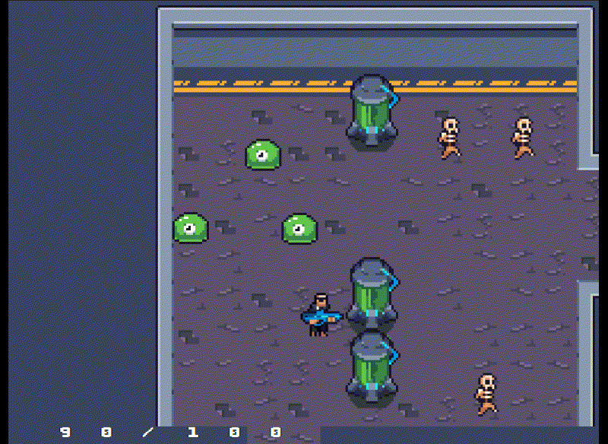
A sample
Notes:
You should have a working knowledge
of basic object-oriented programming concepts and at least some experience
programming in C++.

Slide 21
We want to share...
It has been an amazing experience working on something like this. I would love to be a part of something similar again.
I couldn’t imagine making something like this game until I did and I'm very thankful for everyone here for showing me the way
Notes:
You should have a working knowledge
of basic object-oriented programming concepts and at least some experience
programming in C++.

Slide 22
Thank you!
Notes:
You should have a working knowledge
of basic object-oriented programming concepts and at least some experience
programming in C++.

Slide 23

Questions?
Notes:
You should have a working knowledge
of basic object-oriented programming concepts and at least some experience
programming in C++.

